Slide 1

LaDawn Broberg
M.S. School Library Media
B.S. Elementary/Early Childhood
ESL Endorsement

Slide 2

Professional Development Training
Strategies to use in teaching

Slide 3
Content today:
Assess teachers needs and knowledge of making content comprehensible for ELLs.
Look at the Can Do Descriptors for each of the domains in relation to the test results of the WIDA Online Screener test.
Introduce the teachers to strategies in teaching and the SIOP method.
  The 8 components
  The 30 Features
Give teachers some websites to use as resources.

Slide 4
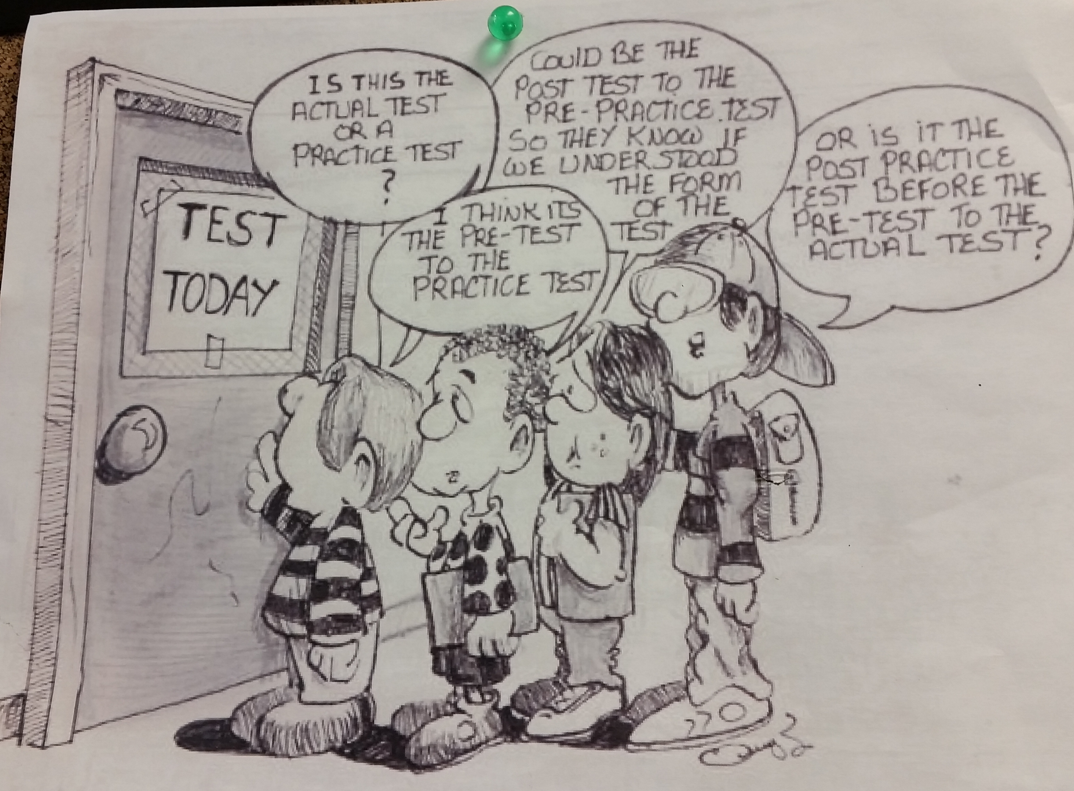

Slide 5
WIDA Screener Test
What is WIDA?
What is the Screener Test?
How do I interpret the results of the test?
What can I do to facilitate the ELLs in my classroom?
What are the Can Do Discriptors
Levels:
 | ELP Level 1 Entering | ELP Level 2 Emerging | ELP Level 3 Developing | ELP Level 4 Expanding | ELP Level 5 Bridging | ELP Level 6 Reaching

Slide 6


Introducing the SIOP Model
(Sheltered Instruction Observation Protocol)
Instruction that impacts
ALL
students

Slide 7
What are other strategies and resources to use?

Slide 8


Introduction to SIOP
The SIOP Model
SIOP in the Classroom
The SIOP Model.pdf
SIOP 99 Ideas Activities
Sheltered Instruction Observation Protocol (SIOP) Strategy Guide for ELL/Bilingual Learners
Websites for Resources:
  WIDA
  Colorin Colorado
  CAL/SIOP
  YouTube videos

Slide 9
8 Components
Preparation
Building Background
Comprehensible Input
Interaction
Practice/Application
Lesson Delivery
Review/Assesment

Slide 10
Preparation
Content objectives (Discuss results of experiment on pressure, volume)
Language objectives (Use if . . . then statement to describe results of experiment on pressure & volume)
Age appropriate content concepts (avoid cognitive remediation)
Supplemental materials (realia)
Adaptation of Content (text)
Meaningful activities (models, simulation)

Slide 11
Building Background
7. Concepts explicitly linked to student background experiences
8. Links explicitly made to past learning
9. Key vocabulary emphasized

Slide 12
Comprehensible Input
Speech appropriate to student ELP
Explanation of academic tasks
Uses a variety of techniques to make content concepts clear

Slide 13
Strategies
Student learning strategies
Use of verbal & instructional scaffolding techniques
Uses question types at different levels of blooms taxonomy

Slide 14
Interaction
Frequent opportunities for student & teacher interactions
Grouping configurations to support lesson objectives
Provides sufficient wait time
Opportunities for students to clarify in L1

Slide 15
Practice/Application
Provides manipulatives for practice
Provides activities to apply content & language knowledge
Activities in all 4 language domains

Slide 16
Lesson Delivery
Content objectives clearly supported in lesson
Language objectives clearly supported in lesson
Students engaged 90-100% of time
Pacing of lesson appropriate

Slide 17
Review/Assessment
Comprehensive review of vocabulary
Comprehensive review of content concepts
Regularly provides feedback on language and content output
Conducts assessment of student comprehension, ongoing basis throughout lesson

Slide 18
Strategies/Ideas and Activities
SIOP 99 Ideas and Activities
Sheltered Instruction Observation Protocol (SIOP) Strategy Guide for ELL/Bilingual Learners
Colorin Colorado Bright Ideas and Video

Slide 19
Lesson Plan Templates
SIOP Lesson Plan Template 1
SIOP Lesson Plan Template 2

